Slide 1
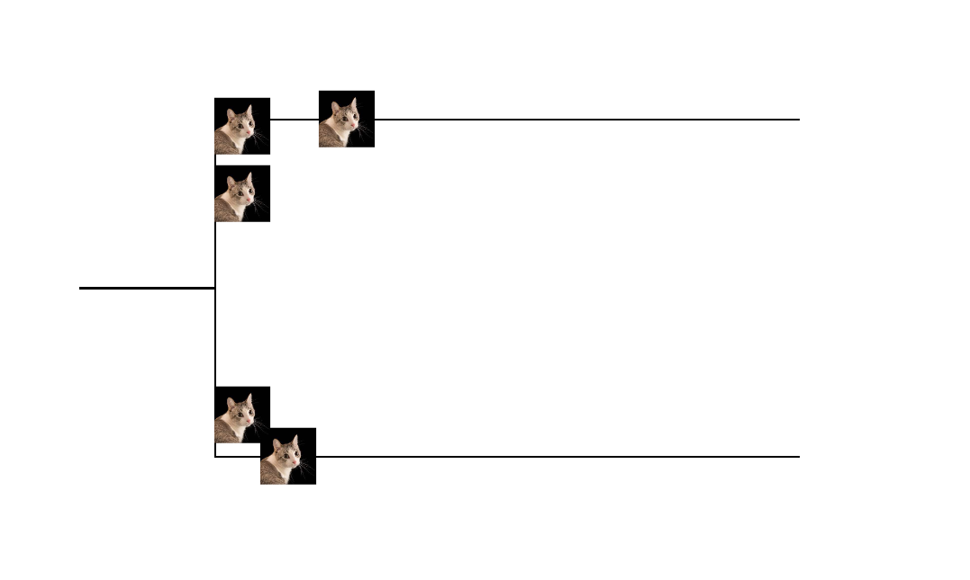
Cat
Dog
yes
Drag and Drop the Condition here!
Has Whiskers?
no
Dog

Slide 2
Order
More
Wifi
Fire
Hans
Order
Juice
Hire
Tom
Order
New
Wifi

Slide 3
